Slide 1
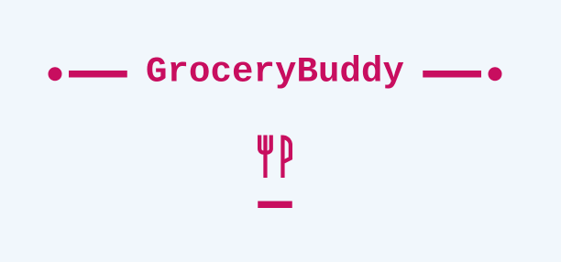
By: Group 1

Slide 2
Presentation Order
Introductions
Introducing Group 1:
Overview/Proposal
Sumaiya Tabassum
Daniel Jacobs
Romaine Ewan
Raissa Padua
Eli Kleinworm
Dan Huynh
Project objective
Front End
Back End
QA
Thank You Conclusions

Slide 3
Overview/Proposal
Build a web product that also functions on mobile, which will guide users to portal to sign in and make an account to gain more functionality of the product.
The product will allow users to be reminded of certain groceries they have to purchase, on a weekly basis. The main benefit of the product is that it will provide comparisons of stores where certain items will be cheaper so user can save money if they choose to. Price comparison will benefit users a lot. The product will not allow users to search any items they want, there will be some limitations.
There will be e-mail reminders and some sort of notifications added. This will be a weekly plan for grocery list. However, we will try to make it into a monthly calendar.

Slide 4
Front End
Our front end experts Raissa Padua and Eli Kleinworm worked towards creating a seamless interface for all users to easily jump in and get started. After signing up through the initial sign up page, the user is then presented with the freedom to navigate and modify the app.

Slide 5
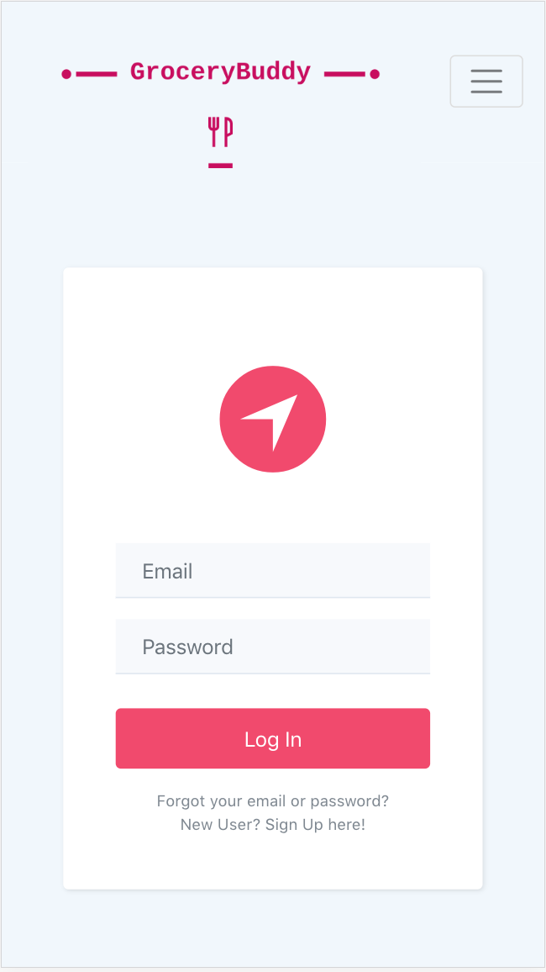
Front End - Log In
As a user you are initially presented with a log in page. Here you are prompted to enter your email and password. Located below the log in button are links to reset your email or password if you forgot either one. You may also Sign up as a user.
To log in enter your full email and password into their respective email and password box. Then click the Log In button. Click the link below the log in button to reset your password should the need present itself. To sign up as a new user, click the second link below the log in button.

Slide 6
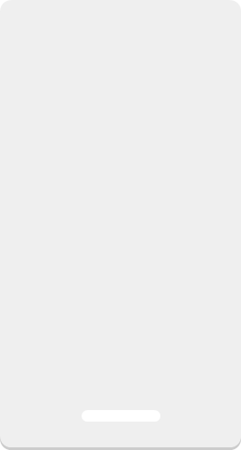
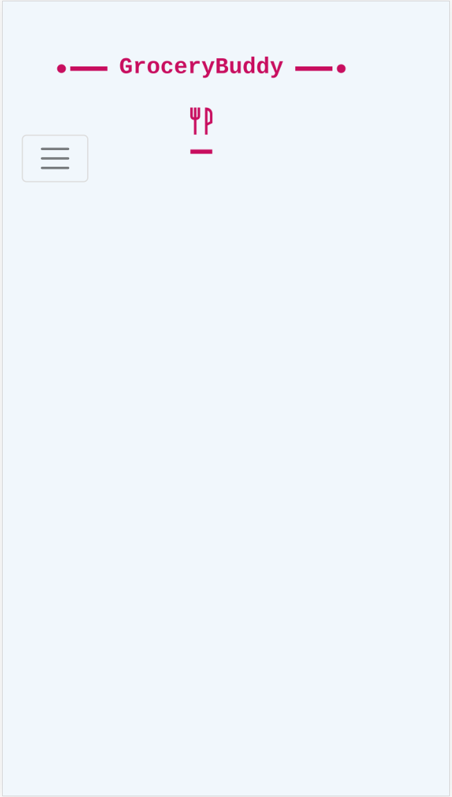
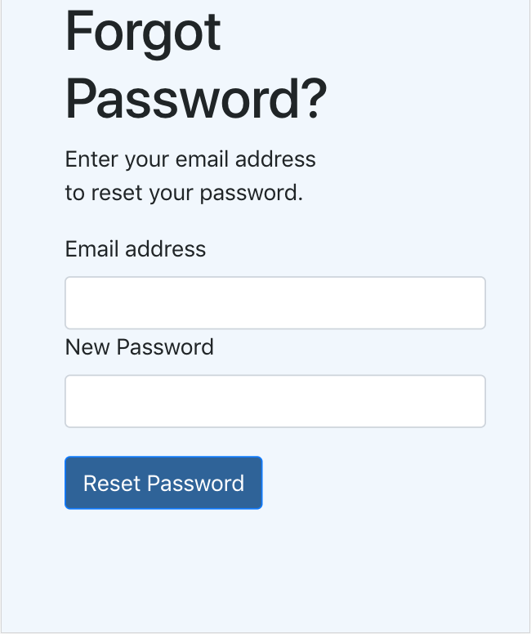
Front End - Forgot Password
On this page you are free to reset your password whenever you want. To accomplish this you’ll need your registered email address and new password.
To begin resetting your password, enter your registered email and password in their respective text boxes. Then click the reset password button below.

Slide 7
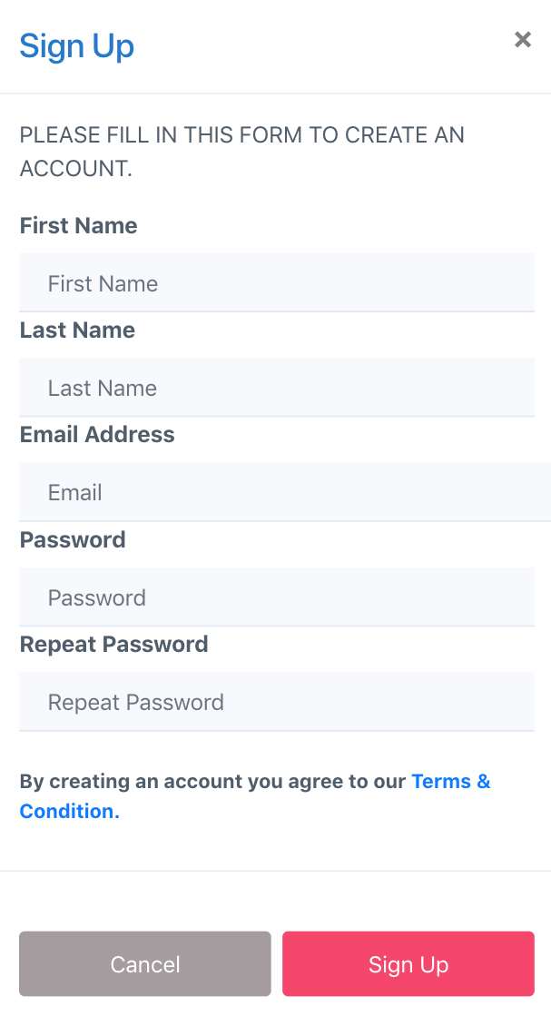
Front End - Sign Up
Here on the sign up page GroceryBuddy allows you to sign up for your personal account on the app. This will allow all your changes and modifications be yours and YOURS ONLY once you begin your GroceryBuddy journey.
As you can see in the image to the left, to sign up you will need to fill out the form with the information it prompts you to enter into each text box. The information you will need is your first name, last name, email address and password.

Slide 8
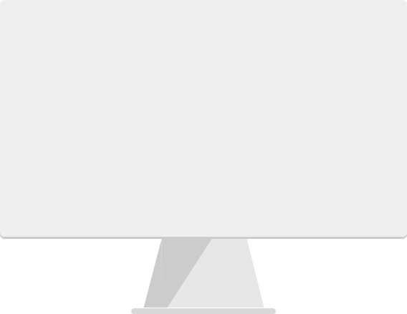
Front End – Home Screen
This home screen is your base of operations for your GroceryBuddy experience. Displayed across the middle to bottom portion of the screen, are the 7 days of the week in calendar format. Each day displays a list with a max of 10 items you are free to add or remove. Items are found by searching them in the item look up bar located to the top left of the screen. You can log out at any time at the top right through the Profile menu.

Slide 9
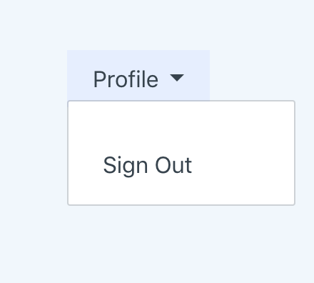
Front End - Sign Out
Once logged in the GroceryBuddy app you can easily log out at anytime. Click the Profile button at the top right of the home screen to see the sign out option. Click sign out to log out of your account to the log in screen.

Slide 10
Front End - Code
Comments on the process of coding the front end.(design decisions, bootstrap)

Slide 11
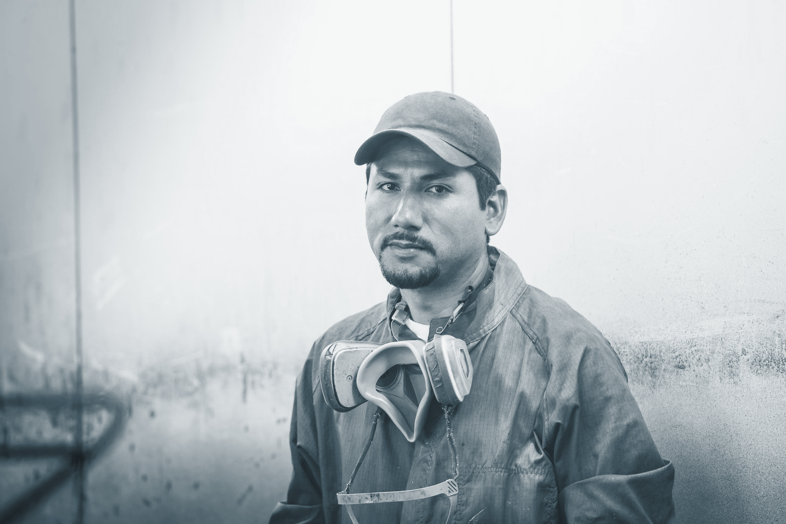


Back End
Our back end experts Daniel Jacobs along with Sumaiya Tabassum and Dan Huynh worked towards creating the a functionality of the database, internet hosting and email aspects of the app. They made it possible for the users to use the app on mobile or desktop. This is while letting you actually see the lowest prices available for certain items they look up in GroceryBuddy and the store they are from.

Slide 12
Back End - Code
Comments on the process of coding the back end.(database, sql, server, php, etc.)

Slide 13
Quality Assurance (QA)
Our QA experts Dan Huynh and Eli Kleinworm, worked towards preventing mistakes and defects in our GroceryBuddy app to avoid problems with the finished product. Seeing it from a customers point of view and a developer’s as well, they conducted testing through different methods to make sure things were how they should be. If any errors were found, they informed they group on them with some advice on how it could be fixed.

Slide 14
QA - Use Case
Comments on the use case diagram and what its for. And problems or obstacles we had to overcome through testing.

Slide 15


Closing
Thank You !
Next

Slide 16
Spotlight on tablet

Slide 17
Spotlight on wearables

Slide 18
Spotlight on wearables

Slide 19
Spotlight on wearables

